Slide 1
CS 471/571
Ch13 The Implementation Workflow

Slide 2
Overview
Choice of programming language
Good programming practices
  Variables, control structures, methods
Integration
Testing issues
Complexity metrics
Cleanroom
Product testing and acceptance testing

Slide 3
References
Textbook
Steve McConnell. Code Complete: A Practical Handbook of Software Construction. 2nd Edition. Microsoft Press, 2004.

Slide 4
The Implementation Workflow
Implement the target software
  A large product is partitioned into subsystems
  Implemented in parallel by coding teams
  Subsystems consist of components or code artifacts
Once the programmer has implemented an artifact, he or she unit tests it
Then the module is passed on to the SQA group for further testing
  This testing is part of the test workflow

Slide 5
Programming Languages
COBOL
Haskell, Erlang, F#
  Functional programming
Clojure, Fantom, Groovy, Scala
  on JVM
Tcl
xBase
…

Slide 6
Choice of Programming Language
The language is usually specified in the contract
What if the contract specifies the use of the “most suitable” language?
Example
  QQQ Corporation has been writing COBOL programs for over 25 years
  Over 200 software staff, all with COBOL expertise
  What is “the most suitable” programming language?
  Obviously COBOL

Slide 7
Choice of Language (contd)
What if a new language (C++, say) is introduced
  C++ professionals must be hired
  Existing COBOL professionals must be retrained
  Future products are written in C++
  Existing COBOL products must be maintained
  There are two classes of programmers
    COBOL maintainers (despised)
    C++ developers (paid more)
  Expensive software, and the hardware to run it, are needed
  100s of person-years of expertise with COBOL are wasted

Slide 8
Choice of Language (contd)
The only possible conclusion
  COBOL is the “most suitable” programming language
And yet, the “most suitable” language for the latest project may be C++
  COBOL is suitable for only data processing applications
How to choose a programming language
  Cost–benefit analysis
  Compute costs and benefits of all relevant languages

Slide 9
Choice of Language (contd)
Which is the most appropriate OO language?
  C++ is (unfortunately) C-like
  Every classical C program is a C++ program
  Java enforces the OO paradigm
  Training in the OO paradigm is essential before adopting any OO language
Some languages are better at expressing programming concepts than others
  Your ability to think a thought depends on knowing words capable of expressing the thought
  If you don’t know the words, you can’t express the thought, and you might not even be able to formulate it

Slide 10
Your Location on the Tech Wave
Technology waves
  PC vs mainframe
  GUI vs. character-based programs
  Web programming
  Mobile programming
  Cloud programming
Technology cycles or waves imply different programming practices depending where you find yourself on the wave.

Slide 11
Your Location on the Tech Wave
How you spend your programming days will depend on where you are on the tech wave!
  In the late part of the wave, you can plan to spend most your day steadily writing new functionality
  In the early part, you will spend a portion of your time trying to figure out undocumented features, debugging errors…
Late wave environments
  Web programming now - numerous programming language choices, comprehensive error checking, powerful debugging tools, automatic reliable performance optimization, etc
Early wave environments
  Web programming in mid-1990s, the situation is opposite
  Some innovative applications arise from early-wave programs, e.g. MS Word

Slide 12
Data Literacy Test
abstract data type
array
bitmap
boolean variable
b-tree
character variable
container class
double precision
elongated stream
enumerated type
floating point
heap
index
integer
linked list
named constant
literal
local variables
lookup table
member data
pointer
private
retroactive synapse
referential integrity
stack
string
structured variable
tree
typedef
union
value chain
variant
Total Score
1: familiar 0.5: know what a term means but aren’t sure

Slide 13
Loose Interpretation
0-14: beginning programmer
15-19: intermediate programmer, or
  An experienced programmer who has forgotten a lot
20-24: expert programmer
25-29: know more about data types than Steve
  Consider writing your own book
30-32: you are a pompous fraud
  Elongated stream, retroactive synapse, value chain don’t refer to data types

Slide 14
Programming Practice: Variables
Use of consistent and meaningful variable names
  “Meaningful” to future maintenance programmers
  “Consistent” to aid future maintenance programmers
A code artifact includes the variable names freqAverage, frequencyMaximum, minFr, frqncyTotl
  A maintenance programmer has to know if freq, frequency, fr, frqncy all refer to the same thing
  If so, use the identical word, preferably frequency, perhaps freq or frqncy, but not fr
  If not, use a different word (e.g., rate) for a different quantity

Slide 15
Variable Names
We can use frequencyAverage, frequencyMaximum, frequencyMinimum, frequencyTotal
We can also use averageFrequency, maximumFrequency, minimumFrequency, totalFrequency
All four names must come from the same set

Slide 16
Kinds of Names to Avoid
Avoiding misleading names or abbreviations
Avoid names with similar meanings
  recordNum/numRecords
Avoid names that sound similar
  wrap/rap
Avoid numerals in names
Avoid misspelled words in names
Don’t differentiate names solely by capitalization
Avoid multiple natural languages
  check/cheque

Slide 17
Kinds of Names to Avoid - cont
Avoid the names of standard types, variables, and methods
    If if=then then
    then = else;
    else else = if; // PL/1
Avoid names containing hard-to-read chars
  (1, l, I), (0, O), (2, Z), (S, 5), ...
Don’t use names that are totally unrelated to what the variables represent

Slide 18
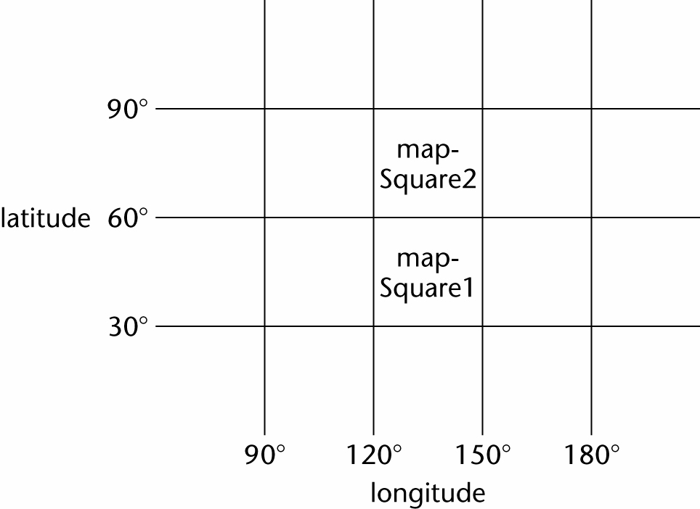
Nested if Statements
A map consists of two squares. Write code to determine whether a point on the Earth’s surface lies in map_square_1 or map_square_2, or is not on the map

Slide 19
Nested if Statements (contd)
Solution 1. Badly formatted

Slide 20
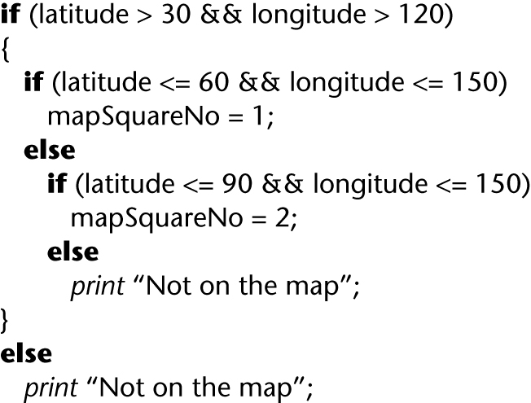
Nested if Statements (contd)
Solution 2. Well-formatted, badly constructed

Slide 21
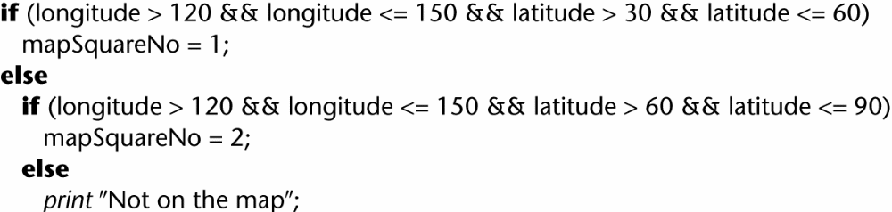
Nested if Statements (contd)
Solution 3. Acceptably nested

Slide 22
Nested if Statements (contd)
A combination of if-if and if-else-if statements is usually difficult to read
Simplify: The if-if combination
  if <condition1>
  if <condition2>
is frequently equivalent to the single condition
  if <condition1> && <condition2>
Rule of thumb
  if statements nested to a depth of greater than three should be avoided as poor programming practice

Slide 23
Days-in-Month Example
if (month==1)
  days =31;
else if (month==2)
  days = 28;
else if (month==3)
  days = 31;
…
else if (month == 12)
  days = 31;
Leap year: more complicated

Slide 24
Days-in-Month Example - cont
int daysPerMonth[] = {31,28, 31, 30,…, 31};
days = daysPerMonth[month-1];
Leap year
days = daysPerMonth[month-1] +
leapYearIndex(); // 0/1

Slide 25
Methods: Valid Reasons
Public interface
Reduce complexity
Introduce an intermediate, understandable abstraction
  Putting a section of code into a well-named routine is one of the best way to document its purpose
  if (node<>null) then
      while (node.next<>null) do
        node=node.next
        leafName = node.name
      end while
    else leafName = “”
    end if
  leafName = getLeafName(node)
Notes:
Bug: leafName = node.name (null pointer)? It should be put before node = node.next.

Slide 26
Methods: Valid Reasons - cont
Avoid duplicate code
  Creation of similar code in two routines implies an error in decomposition
Support subclassing
  Need less new code to override a short, well-factored routine than a long, poorly factored routine
  Reduce the chance of error in subclass if overrideable routines are kept simple
Hide sequences
  Independently get data from the user and from a file

Slide 27
Methods: Valid Reasons - cont
Hide pointer operations
Improve portability
Simplify complicated boolean tests
  Get the details of the test out of the way
  A descriptive name summarizes the purpose
Improve performance
  Having code in one place will make it easier to profile to find inefficiencies
  Optimize the code in one place instead of in several places

Slide 28
Operations That Seem Too Simple
Assume the calculation in a dozen places
  points = deviceUnits * (POINTS_PER_INCH/deviceUnitsPerInch())
What does the expression mean?
  Convert a measurement in device units to a measurement in points
Put the expression into a method?

Slide 29
Method Version
int deviceUnitsToPoints(int deviceUnits) {
return deviceUnits *
(POINTS_PER_INCH/deviceUnitsPerInch())
}
Method Call
  points = deviceUnitsToPoints(deviceUnits)
  More readable – even approaching self-doc
Any other benefit of the method?
Notes:
What if realize later that DeviceUnitsPerInch() may return 0!

Slide 30
Design at Method Level
Cohesion – how closely the operations are related
  cosine vs cosineAndTan
  Higher reliability
    Card et al 1986: 50% (18%) of 450 highly (lowly) cohesive routines were fault free
Functional cohesion
  A method performs one and only operation
  sin, getCustomerName, eraseFile
    Assume they do what their names say they do

Slide 31
Good Method Names
Describe everything the routine does
  Describe all the outputs and side effects
  computeReportTotals - inadequate for ‘compute report totals and open an output file’
  computeReportTotalsAndOpenOutputFile – too long and silly
  Not to use less-descriptive names
  To avoid side effects
Avoid meaningless, vague, or wishy-washy verbs
  handleCalculation, performService, dealWithOutput don’t tell you what the routines do

Slide 32
Good Method Names - cont
Don’t differentiate names solely by number
  OutputUser, OutputUser1, OutputUser2
Make names as long as necessary
  Optimum average length for variables: 9-15
  Routine names tend to be longer
For a function, use a description of the return value
  printer.IsReady, pen.CurrentColor()
Use opposite precisely
  Show/hide, open/close, source/target,…
  FileOpen and _lclose
Establish conventions for common operations

Slide 33
How to Use Parameters
Put parameters in input-modify-output order
  The sequence of operations - inputting data, changing it and sending back a result
If several routines use similar parameters, put them in a consistent order
Use all the parameters
Don’t use parameters as working variables
  int sample (int inputVal) {
    inputVal = inputVal * CurrentMultiplier(inputVal);
    …
    return inputVal;
  }

Slide 34
How to Use Parameters - cont
Document interface assumptions about parameters
  Whether input-only, modified, or output-only
  Units of numeric parameters (inches, meters,…)
  Meanings of status codes and error values if enumerated types are not used
  Ranges of expected values
  Specific values that should never happen
Limit the number of parameters to about 7

Slide 35
Code Layout for Increased Readability
Use indentation
Better, use a pretty-printer
Use plenty of blank lines
  To break up big blocks of code

Slide 36
The Issue of Self-Documenting Code
Self-documenting code is exceedingly rare
The key issue: Can the code artifact be understood easily and unambiguously by
  The SQA team
  Maintenance programmers
  All others who have to read the code
Example:
  Code artifact contains the variable xCoordinateOfPositionOfRobotArm, abbreviated to xCoord
  This is fine, because the entire module deals with the movement of the robot arm
  But does the maintenance programmer know this?

Slide 37
Programming Standards
Standards can be both a blessing and a curse
Modules of coincidental cohesion arise from rules like
  “Every module will consist of between 35 and 50 executable statements”
Better
  “Programmers should consult their managers before constructing a module with fewer than 35 or more than 50 executable statements”

Slide 38
Remarks on Programming Standards
No standard can ever be universally applicable
Standards imposed from above will be ignored
Standard must be checkable by machine

Slide 39
Examples of Good Programming Standards
“Nesting of if statements should not exceed a depth of 3, except with prior approval from the team leader”
“Modules should consist of between 35 and 50 statements, except with prior approval from the team leader”
“Use of gotos should be avoided. However, with prior approval from the team leader, a forward goto may be used for error handling”

Slide 40
Remarks on Programming Standards (contd)
The aim of standards is to make maintenance easier
  If they make development difficult, then they must be modified
  Overly restrictive standards are counterproductive
  The quality of software suffers

Slide 41
Integration
The approach up to now:
  Implementation followed by integration
This is a poor approach
Better:
  Combine implementation and integration methodically

Slide 42
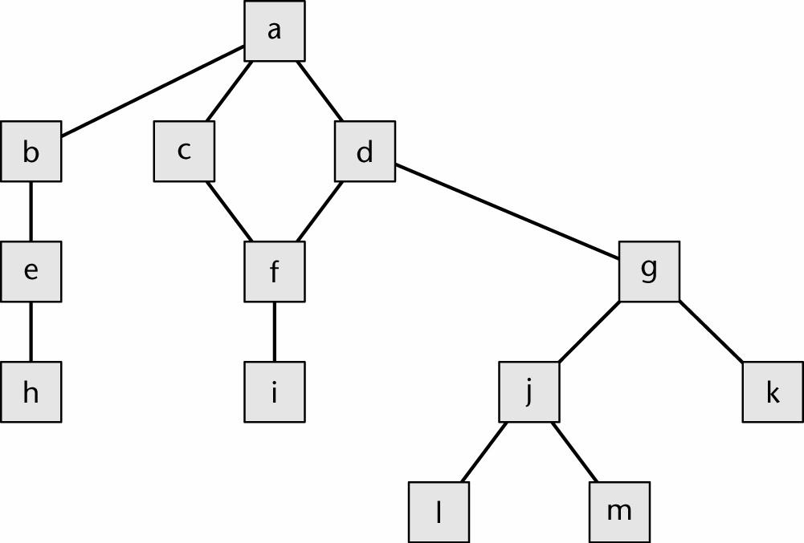
Product with 13 Modules
Notes:
An upper level calls the lower level.

Slide 43
Implementation, Then Integration
Code and test each code artifact separately
Link all 13 artifacts together, test the product as a whole

Slide 44
Drivers and Stubs
To test artifact a, artifacts b,c,d must be stubs
  An empty artifact, or
  Prints a message ("Procedure radarCalc called"), or
  Returns precooked values from preplanned test cases
To test artifact h on its own requires a driver, which calls it
  Once, or
  Several times, or
  Many times, each time checking the value returned
Testing artifact d requires a driver and two stubs

Slide 45
Implementation, Then Integration (contd)
Problem 1
  Stubs and drivers must be written, then thrown away after unit testing is complete
Problem 2
  Lack of fault isolation
  A fault could lie in any of the 13 artifacts or 13 interfaces
  In a large product with, say, 103 artifacts and 108 interfaces, there are 211 places where a fault might lie
Solution to both problems
  Combine unit and integration testing

Slide 46
Top-down Integration
If code mAbove sends a message to mBelow, then mAbove is implemented/integrated before mBelow
One possible top-down ordering is
  a,b,c,d,e,f,g,
  h,i,j,k,l,m

Slide 47
Top-down Integration (contd)
Another possible top-down ordering is
  a
  [a] b,e,h
  [a] c,d,f,i
  [a,d,f] g,j,k,l,m

Slide 48
Top-down Integration (contd)
Advantage 1: Fault isolation
  A previously successful test case fails when mNew is added to what has been tested so far
  The fault must lie in mNew or the interface(s) between mNew and the rest of the product
Advantage 2: Stubs are not wasted
  Each stub is expanded into the corresponding complete artifact at the appropriate step

Slide 49
Top-down Integration (contd)
Advantage 3: Major design flaws show up early
Logic artifacts include the decision-making flow of control
  In the example, artifacts a,b,c,d,g,j
Operational artifacts perform the actual operations of the product
  In the example, artifacts e,f,h,i,k,l,m
The logic artifacts are developed before the operational artifacts

Slide 50
Top-down Integration (contd)
Problem 1
  Reusable artifacts are not properly tested
  Lower level (operational) artifacts are not tested frequently
  The situation is aggravated if the product is well designed
Defensive programming (fault shielding)
  Example:
  if (x >= 0)
    y = computeSquareRoot (x, errorFlag);
  computeSquareRoot is never tested with x < 0
  This has implications for reuse

Slide 51
Bottom-up Integration
If code artifact mAbove calls code mBelow, then mBelow is implemented and integrated before mAbove
One possible bottom-up ordering is
  l,m,h,i,j,k,e,
  f,g,b,c,d,a

Slide 52
Bottom-up Integration (contd)
Another possible bottom-up ordering is
h,e,b
i,f,c,d
l,m,j,k,g [d]
a [b,c,d]

Slide 53
Bottom-up Integration (contd)
Advantage 1
  Operational artifacts are thoroughly tested
Advantage 2
  Operational artifacts are tested with drivers, not by fault shielding, defensively programmed artifacts
Advantage 3
  Fault isolation

Slide 54
Bottom-up Integration (contd)
Difficulty 1
  Major design faults are detected late
Solution
  Combine top-down and bottom-up strategies making use of their strengths and minimizing their weaknesses

Slide 55
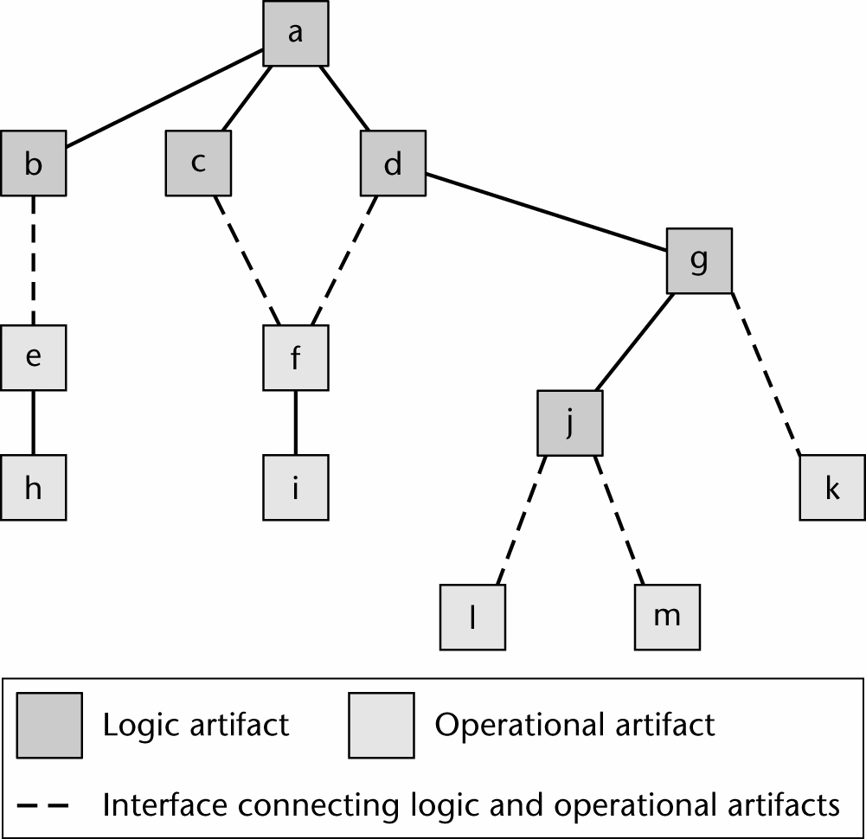
Sandwich Integration
Logic artifacts are integrated top-down
Operational artifacts are integrated bottom-up
Finally, the interfaces between the two groups are tested

Slide 56
Sandwich Integration (contd)
Advantage 1
  Major design faults are caught early
Advantage 2
  Operational artifacts are thoroughly tested
  They may be reused with confidence
Advantage 3
  There is fault isolation at all times

Slide 57
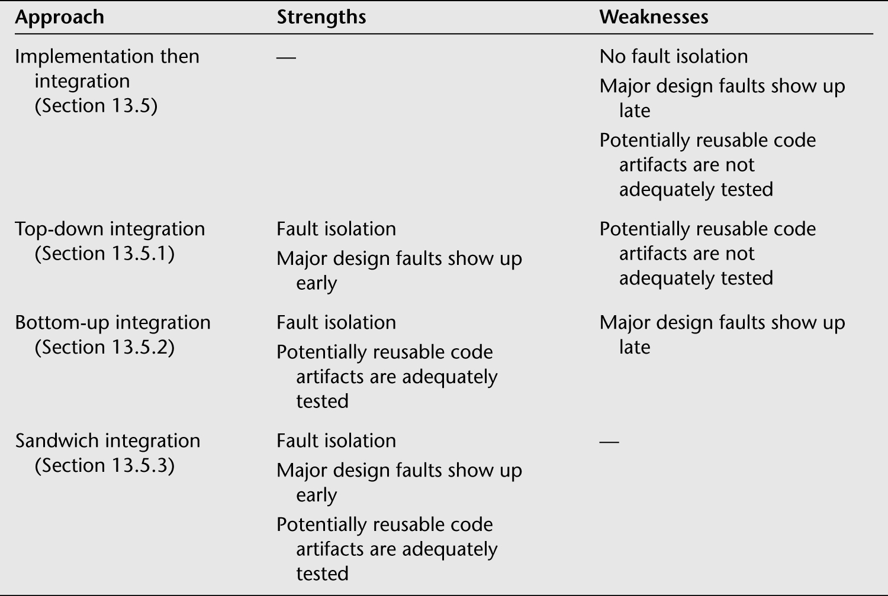
Summary

Slide 58
Integration Techniques
Implementation and integration
  Almost always sandwich
  Objects are integrated bottom-up
  Other artifacts are integrated top-down

Slide 59
Testing to Spec versus Testing to Code
Test to specifications
  Black-box, functional, or input/output driven testing
  Ignore the code — use the specifications to select test cases
Test to code
  White-box, structured, or path-oriented testing
  Ignore the specifications — use the code to select test cases

Slide 60
Feasibility of Testing to Spec (contd)
Suppose the specifications include 20 factors, each taking on 4 values
  There are 4²⁰ test cases
  If each takes 30 seconds to run, running all test cases takes more than 1 million years
The combinatorial explosion makes testing to specifications impossible
Practice: Pairwise and T-Way Testing

Slide 61
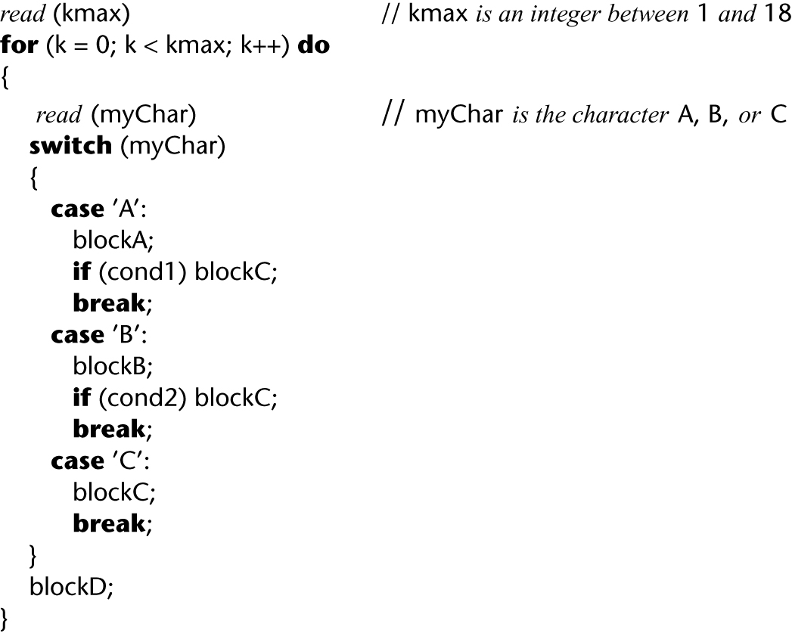
Feasibility of Testing to Code
Each path through a artifact must be executed at least once: Combinatorial explosion

Slide 62
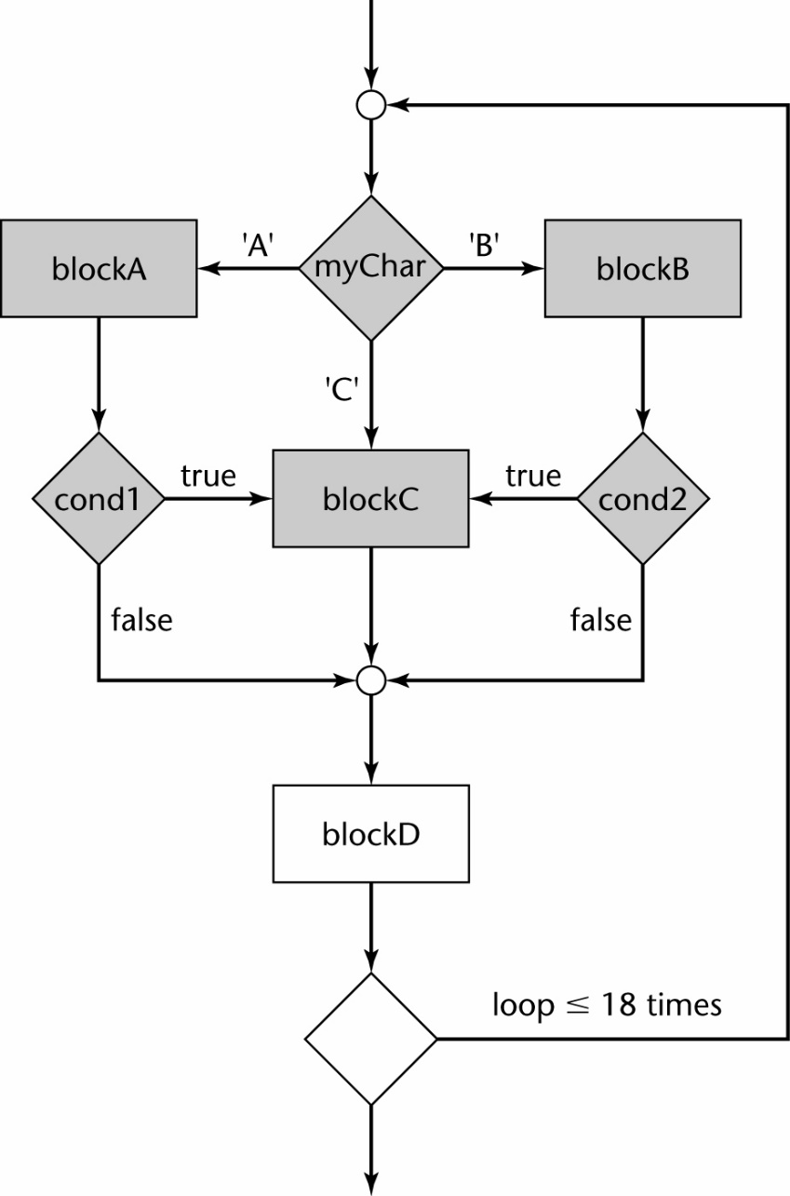
Feasibility of Testing to Code (contd)
> 10¹² different paths

Slide 63
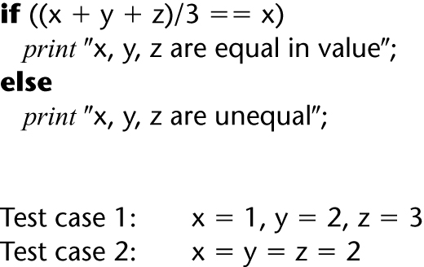
Feasibility of Testing to Code (contd)
Testing to code is not reliable
We can exercise every path without detecting every fault

Slide 64
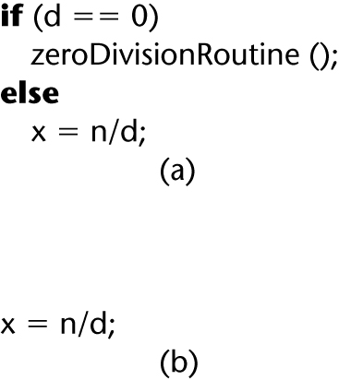
Feasibility of Testing to Code (contd)
A path can be tested only if it is present
A programmer who omits the test for d = 0 in the code probably is unaware of the possible danger

Slide 65
Feasibility of Testing to Code (contd)
Criterion “exercise all paths” is not reliable
  Some data exercising a given path detect a fault, and other data exercising the same path do not

Slide 66
Testing Issues
A method often does not return a value to the caller — it changes state instead
It may not be possible to check the state because of information hiding
  Example: method determineBalance — we need to know accountBalance before, after
We need additional methods to return values of all state variables
  They must be part of the test plan
  Conditional compilation may have to be used
An inherited method may have to be tested

Slide 67
Testing Issues (contd)
Making state variables visible
  Minor issue
Retesting before reuse
  Arises only when methods interact
  We can determine when this retesting is needed
These are not reasons to abandon the object-oriented paradigm

Slide 68
Complexity Metrics
Artifact m1 is more “complex” than artifact m2
  Intuitively, m1 is more likely to have faults than m2
If the complexity is unreasonably high, redesign and then reimplement that code artifact
  This is cheaper and faster than trying to debug a fault-prone code artifact

Slide 69
Lines of Code
The simplest measure of complexity
  Underlying assumption: There is a constant probability p that a line of code contains a fault
Example
  The tester believes each line of code has a 2% chance of containing a fault.
  If the artifact under test is 100 lines long, then it is expected to contain 2 faults
The number of faults is indeed related to the size of the product as a whole

Slide 70
Other Measures of Complexity
Cyclomatic complexity M (McCabe)
  Essentially the number of decisions in the artifact
  Easy to compute
  A surprisingly good measure of faults
In one experiment, artifacts with M > 10 were shown to have statistically more errors
# classes, methods, etc.
Tool: SourceMonitor

Slide 71
Problem with Complexity Metrics
Complexity metrics, as especially cyclomatic complexity, have been strongly challenged on
  Theoretical grounds
  Experimental grounds, and
  Their high correlation with LOC
Essentially we are measuring lines of code, not complexity

Slide 72
Cleanroom
A combination of different techniques
  An incremental process model
  Formal techniques
  Code review and inspection

Slide 73
Cleanroom (contd)
Prototype automated documentation system for the U.S. Naval Underwater Systems Center
1820 lines of FoxBASE
  18 faults were detected by “functional verification”
  Informal proofs were used
  19 faults were detected in walkthroughs before compilation
  There were NO compilation errors
  There were NO execution-time failures

Slide 74
Cleanroom (contd)
Testing fault rate counting procedures differ:
Usual paradigms:
  Count faults after informal testing is complete (once SQA starts)
Cleanroom
  Count faults after inspections are complete (once compilation starts)

Slide 75
Report on 17 Cleanroom Products
Operating system
  350,000 LOC
  Developed in only 18 months
  By a team of 70
  The testing fault rate was only 1.0 faults per KLOC
Various products totaling 1 million LOC
  Weighted average testing fault rate: 2.3 faults per KLOC
“[R]emarkable quality achievement”

Slide 76
Product Testing
Product testing for COTS software
  Alpha, beta testing
Product testing for custom software
  The SQA group must ensure that the product passes the acceptance test
  Black box test cases for the product as a whole
  Robustness of product as a whole
    Stress testing (under peak load)
    Volume testing (e.g., can it handle large input files?)
  All constraints must be checked
  All documentation must be
    Checked for correctness, conformity with standards
    Verified against the current version of the product

Slide 77
Acceptance Testing
After product testing, the product (code plus documentation) is handed over to the client organization for acceptance testing
The client determines whether the product satisfies its specifications
Acceptance testing is performed by
  The client organization, or
  The SQA team in the presence of client representatives, or
  An independent SQA team hired by the client

Slide 78
Acceptance Testing (contd)
Four major components of acceptance testing
  Correctness
  Robustness
  Performance
  Documentation
These are precisely what was tested by the developer during product testing
  Acceptance testing is performed on actual data
  Product testing is performed on test data, which can never be real, by definition

